Slide 1
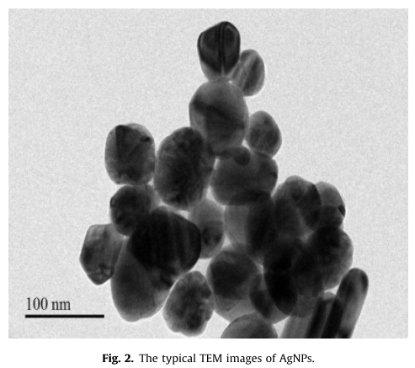
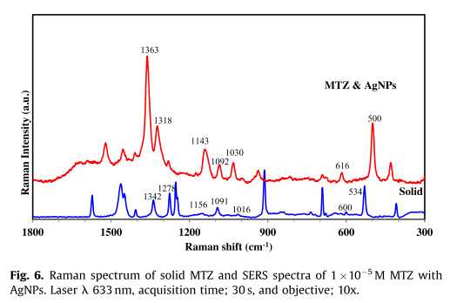
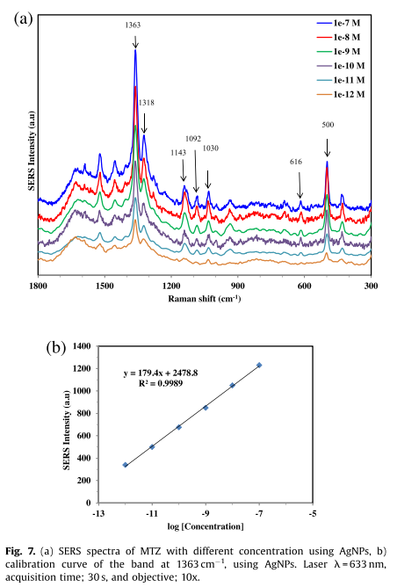
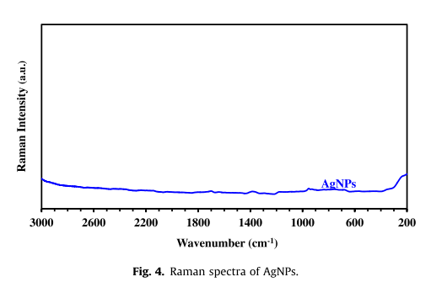
Silver nanoparticles for detection of methimazole by surface-enhanced Raman spectroscopy
Conditions:
Laser: 10% power
Samples: 3:1 volume ratio
Cuvettte: 1 cm radius
SERS spectra:
400 to 2000 cm ⁻¹
﻿ T.A. Saleh et al. / Materials Research Bulletin 91 (2017) 173–178

